Slide 1
LEAD SCORING CASE STUDY
SUBMITTED BY -Ruchira Dolai

Slide 2
Objective: X Education expects to help them select the most promising leads, i.e. the leads that are most likely to convert into paying customers. The company wants us to build a model wherein we need to assign a lead score to each of the leads such that the customers with higher lead score have a higher conversion chance and the customers with lower lead score have a lower conversion chance. The CEO, in particular, has given a ballpark of the target lead conversion rate to be around 80%.

Slide 3
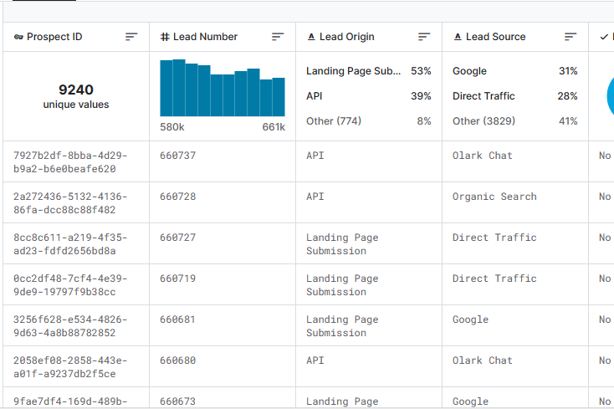
ANALYSIS approach from datatset
Data understanding and Exploring
From leads dataset
T
T
Data Cleaning and Prepare for data model

Slide 4
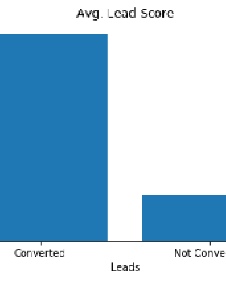
Model outcome
Model outcome for lead score above 35.
Higher the lead score, more chance the lead customer to get converted.
Average lead score of converted leads 68, of non converted leads 15.
Optimum probability cutoff is 0.5

Slide 5
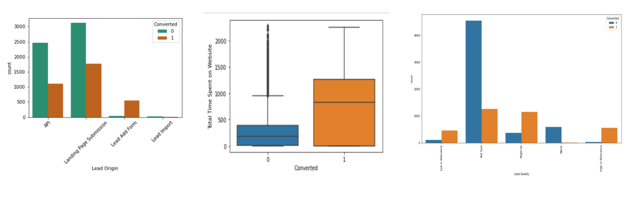
Lead Origin: Lead Add form higest conversion.
Total time spent on website: People with most total time have high conversion rate.
Lead Quality: Efforts to be made to correct idea of relevance of person incharge of lead.

Slide 6
Accuracy Specificity and Sensitivity

Slide 7
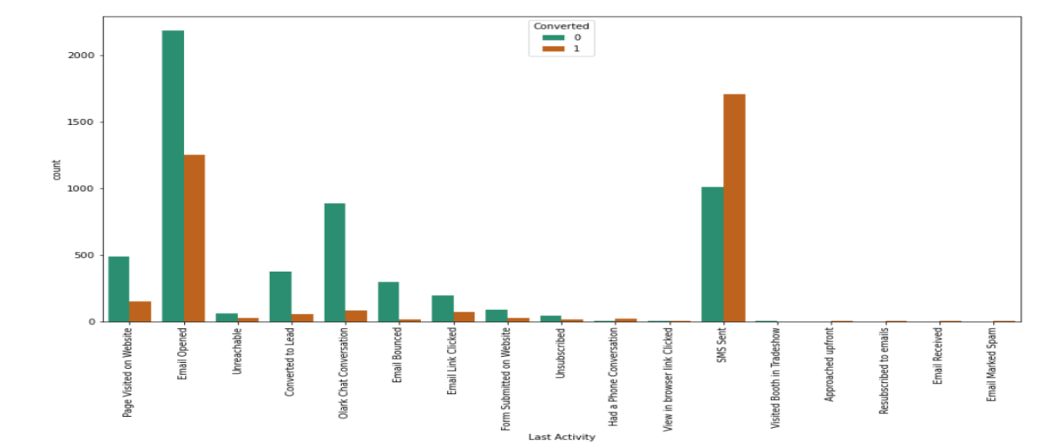
Last Activity by customers who have sms and email facility availed have good conversion rates.

Slide 8
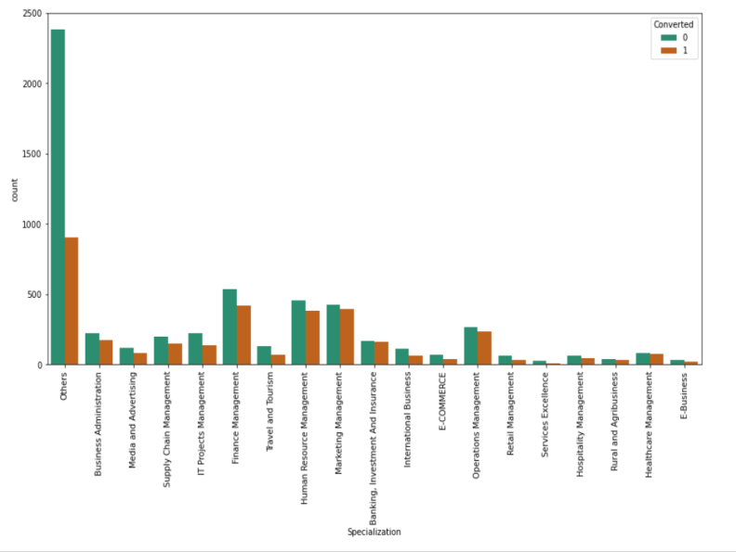
Specialization with the chart mentions converted and non converted data.
The count of others under specialization is more and can be filtered out.

Slide 9
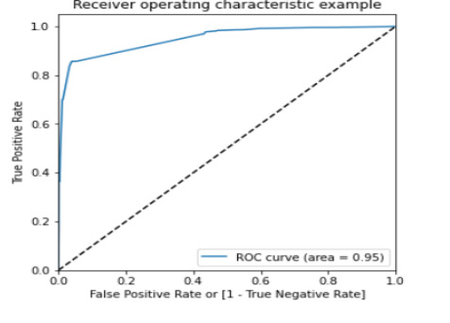
Recommendations
Area under ROC is 0.95
Treating missing values and getting rid of outliers is important.
Remove the features which created imbalance during merging values.
Positive and false rates required for Gini of the Model.
GINI MODEL

Slide 10
Thank You

